Slide 1
AI applications in Finance
Lecture 2
Introduction to Neural Networks
12-Nov-2020
Indranil Dutta

Slide 2
Recap
Big investments in industry (across sectors) towards machine learning
Availability of massive datasets and computing infrastructure enable machine learning.
Value addition through machine learning is the ability to ‘anticipate the future’ and tailor interventions for better outcomes.
Machine learning approaches involve
Learning through training
Validation trough testing
Predict/ provide output
Keras : Open source library for Artificial Neural networks via Python.
TensorFlow: Open source platform for Machine Learning from Google.

Slide 3
Agenda – Session 2
Learning
Neuron and Perceptron
Neural Network Fundamentals
Backpropagation
Types of neural networks

Slide 4

Fun Fact : AI and the US Election
Analyzed 500000 social media posts.
Found
Biden associated with ‘hope’ and ‘success’
Trump associated with ‘fear’ and ‘hatred’
Ranked these according to emotional intensity and frequency
Predicted
Biden win in the popular vote by 2.9 %
Actual 3.4 % as of Nov 11 (New York Times)
Key Benchmark Measure: Human Performance Level (HPL)
Source: https://www.expert.ai/products; DeepLearning.AI(thebatch@deeplearning.ai)

Slide 5
Learning

Slide 6
Types
Category A : Learning Problems
Supervised learning
Unsupervised learning
Reinforcement learning
Category C : Statistical Inference
Inductive learning
Deductive Inference
Transductive learning
Category B : Hybrid Learning Problems
Semi - Supervised learning
Self - Supervised learning
Multi Instance learning
Category D : Learning Techniques
Multitask learning
Active learning
Online learning
Transfer learning
Ensemble learning
Source: https://machinelearningmastery.com/types-of-learning-in-machine-learning/

Slide 7
Learning Problems
Supervised Learning
Supervised learning describes a class of problem that involves using a model to learn a mapping between input examples and the target variable.
The term supervised learning originates from the view of the target y being provided by an instructor or teacher who shows the machine learning system what to do.
— Page 105, Deep Learning, 2016.
2 main types of supervised learning problems
Classification -> predict a ‘class’ label.
Regression -> predict a numerical value.
Both can have multiple inputs (any data type)
Sourcehttps://machinelearningmastery.com/types-of-learning-in-machine-learning/

Slide 8
Learning Problems
Classification types:
Classification predictive modeling involves assigning a class label to input examples.
Binary classification refers to predicting one of two classes
Multi-class classification involves predicting one of more than two classes.
Multi-label classification involves predicting one or more classes for each example
Imbalanced classification refers to classification tasks where the distribution of examples across the classes is not equal.
Source: https://machinelearningmastery.com/types-of-classification-in-machine-learning/#:~:text=In%20machine%20learning%2C%20classification%20refers,one%20of%20the%20known%20characters.

Slide 9
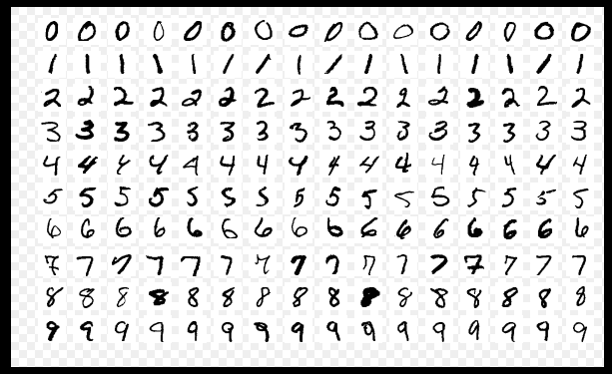
Learning Problems
Example of Classification
Input : Image of handwritten digits
Classifier
0,1,2,3,4,5,6,7,8,9
Output : Class label for what digit each image represents
MNIST database (Modified National Institute of Standards and Technology database)
Source : https://machinelearningmastery.com/types-of-learning-in-machine-learning/

Slide 10
Learning Problems
Example of Regression
Input : File with 13 attributes
crime rate, proportion of nonretail business acres, chemical concentrations and more.(numerical)
Classifier
House Price
Output : Price of house in $
Performance Monitor : Mean Square Error
Boston House Price Dataset
Source: https://machinelearningmastery.com/types-of-learning-in-machine-learning/

Slide 11
Learning Problems
Unsupervised Learning
Model the underlying structure or distribution of the data
Have only input data no corresponding output variables.
No correct answers and no teachers.
2 main types of unsupervised learning problems
Clustering -> discover the inherent groupings in the data,
such as grouping customers by purchasing behavior.
Association -> discover rules that describe large portions of your data,
such as people that buy X also tend to buy Y.
Source :https://machinelearningmastery.com/supervised-and-unsupervised-machine-learning-algorithms/

Slide 12
Learning Problems
Example of Clustering
Sensational article
(Fake)
Identifying Fake News (based on content)
Identify the words and cluster them
Genuine
article
http://snap.stanford.edu/mis2/files/MIS2_paper_2.pdf
Source :https://datafloq.com/read/7-innovative-uses-of-clustering-algorithms/6224

Slide 13
Learning Problems
Example of Association
Analyzing retail sales to find the best way to place items in a store.
Million transactions a year,
10,000 sales newborn baby diapers (1%)
100,000 include razor blades. (10%)
At first glance, newborn diapers and razors seem
statistically independent,
no apparent correlation.
But rule mining would dig deeper into the transaction frequency and find out that 5,000 sales include both items.
Conclusion ->
50% of all shoppers purchasing newborn diapers will also buy razor blades,
Beneficial information for marketing campaigns.
Source: https://deepai.org/machine-learning-glossary-and-terms/association-learning

Slide 14
Learning Problems
What type of learning is involved the following examples?
Spam Filter
Audience segmentation.
Churn Prediction
Predicting age of a person
Customer persona investigation
Conversion Prediction (buy or not)
Pattern recognition (grouping images)
Fraud Detection
Anomaly detection (for example, to detect bot activity)
Predict the number of copies a music album will be sold next month
Predict salary of employee based on age.
Inventory management (by availability)
Sourcehttps://machinelearningmastery.com/types-of-learning-in-machine-learning/, https://www.geeksforgeeks.org/regression-classification-supervised-machine-learning/, https://medium.com/datadriveninvestor/regression-in-machine-learning-296caae933ec , https://theappsolutions.com/blog/development/unsupervised-machine-learning/

Slide 15
Neuron and Perceptron

Slide 16
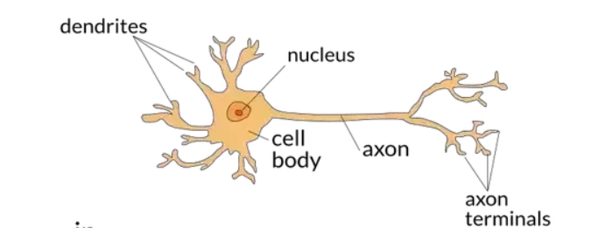
Neuron : Structure
Biological
Source; https://towardsdatascience.com/the-differences-between-artificial-and-biological-neural-networks-a8b46db828b7

Slide 17
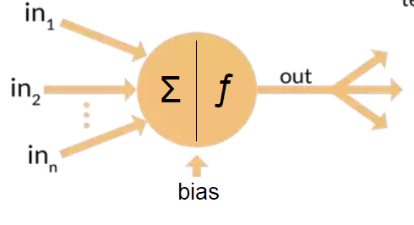
Neuron : Structure
Artificial
Source: https://towardsdatascience.com/the-differences-between-artificial-and-biological-neural-networks-a8b46db828b7

Slide 18
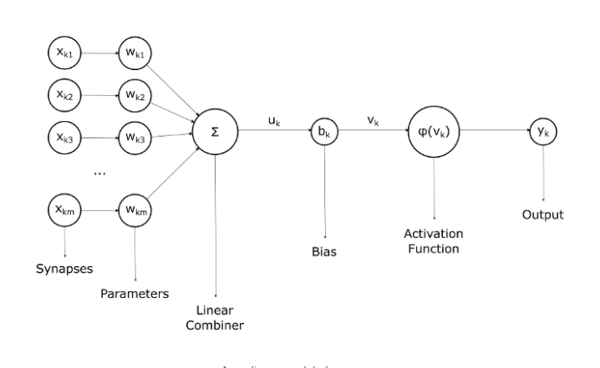
Neuron : Structure
Artificial
Source: https://medium.com/artificial-neural-networks/introduction-to-neurons-in-neural-networks-71828d040a65

Slide 19
Artificial Neuron : Parts
Synapse
A synapse is basically an input signal to the neuron. A synapse is also known as a connecting link.
Every neuron in a neural network expects a set of synapses.
Parameter
A synapse is multiplied with a corresponding special value known as parameter or weight. The parameter is determined during the learning phase from the training set.
Linear Combiner
After the synapses are multiplied with their respective parameters, they are all added together at the summing junction, which is also known as the linear combiner.
Source: https://medium.com/artificial-neural-networks/introduction-to-neurons-in-neural-networks-71828d040a65

Slide 20
Artificial Neuron : Parts
Bias
An external value known as bias is added to the output of the summing junction. The newly evaluated value is known as the induced local field or activation potential. The bias either increases or decreases the result of the summing junction.
Activation Function
A special function known as the activation function limits the strength of the output of the neuron. In other words, it puts the output to values between [0, 1] or [-1, 1].
In summary:
Step 1 : Multiply inputs to their corresponding weights
Step 2: Add all elements from Step 1.
Step 3 : Add the bias value to result in Step 2.
Step 4 : Feed the result from Step 3 to the activation function to get results.
Source: https://medium.com/artificial-neural-networks/introduction-to-neurons-in-neural-networks-71828d040a65

Slide 21
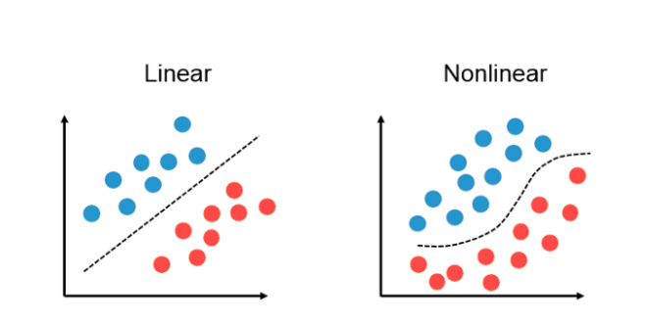
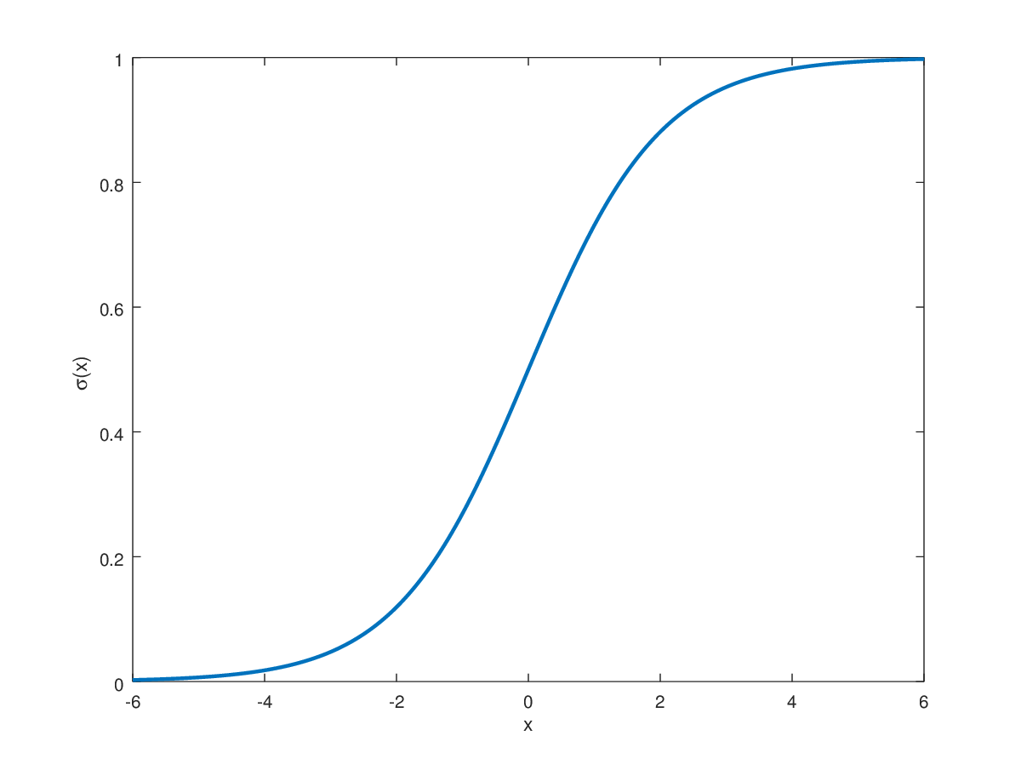
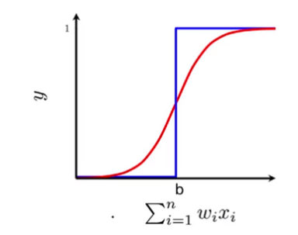
Artificial Neuron : Activation function
Why is it needed?
To introduce non – linearity.
Without this,
output would be addition of weights*inputs and bias value.
Example : Sigmoid function
Source: https://highontechs.com/deep-learning/activation-functions-why-are-they-important/https://hvidberrrg.github.io/deep_learning/activation_functions/assets/sigmoid_function.png https://towardsdatascience.com/sigmoid-neuron-deep-neural-networks-a4cd35b629d7 , https://towardsdatascience.com/neural-networks-fundamentals-1b4c46e7dbfe

Slide 22
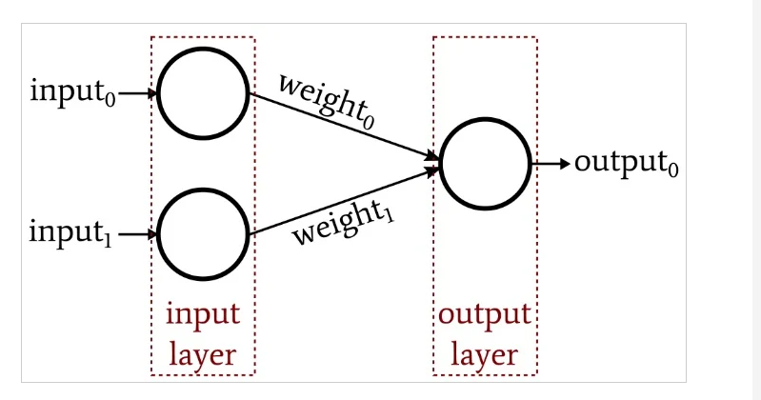
Perceptron
Simplest example of a neural network
Source: https://www.allaboutcircuits.com/technical-articles/how-to-perform-classification-using-a-neural-network-introducing-the-perceptron/

Slide 23
Perceptron
Concepts:
The dimensionality of the input data must match the dimensionality of the input layer.
No of inputs = No of nodes in the input layer.
Can also be thought of the input factors that are related to the problem/issue at hand.
The number of output nodes depends on the application.
For a yes/no classification -> only one output node
For categorization into many types -> multiple output nodes.
Data that move from one node to another are multiplied by weights.
This is key to the Perceptron’s functionality.
Weights are modified during the training process
Weights are adjusted automatically in accordance with the patterns contained in the training data
Network learns to produce useful output.
Source: https://www.allaboutcircuits.com/technical-articles/how-to-perform-classification-using-a-neural-network-introducing-the-perceptron/

Slide 24
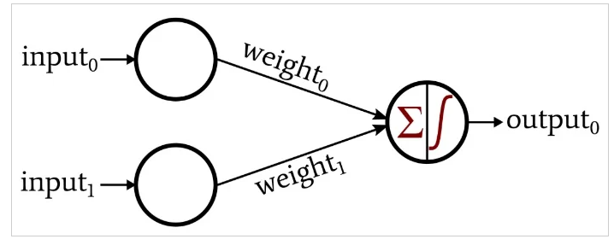
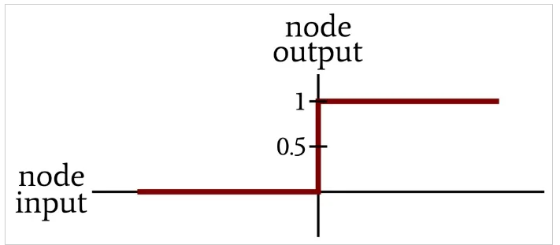
Perceptron
How it works
Activation function
Source: https://www.allaboutcircuits.com/technical-articles/how-to-perform-classification-using-a-neural-network-introducing-the-perceptron/

Slide 25
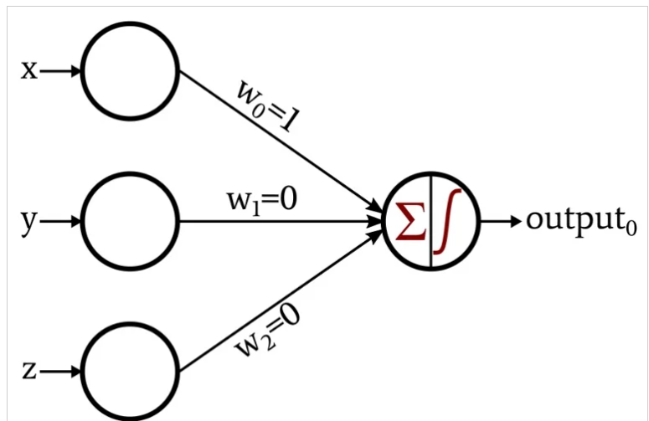
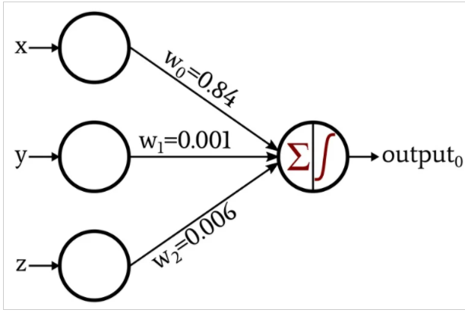
Perceptron in action
Start
End
After training
Source :https://www.allaboutcircuits.com/technical-articles/how-to-train-a-basic-perceptron-neural-network/

Slide 26
Perceptron in action
Concepts
Learning rate (α) : Value that
controls how much to change the model
In response to the error in each step
When weights are adjusted
If too low – training process becomes long and can get stuck
If too high – weights not correct and/or network becomes unstable.
Epoch : Each complete pass through the entire training set is called an epoch.
Can use the same training set multiple times.
Delta (δ ) : Expected Output Value (from Training Set) – Actual Output Value (from Network)
Source :https://machinelearningmastery.com/understand-the-dynamics-of-learning-rate-on-deep-learning-neural-networks/, https://www.allaboutcircuits.com/technical-articles/how-to-train-a-basic-perceptron-neural-network/

Slide 27

Perceptron : Training
Steps involved:
Define the learning parameter
Load the training set
Assign random values to weights initially
Loop
For each row in training set
Calculate network output
Sum of weights*inputs
Subject to threshold function
Adjust weights as per the following
Source :https://www.allaboutcircuits.com/technical-articles/how-to-train-a-basic-perceptron-neural-network/

Slide 28
Neural Network Fundamentals

Slide 29
Neural Networks
Global Architecture
Neural networks have three categories of layers:
Input layer:
This receives the information that are related to the problem at hand (remember dimensionality)
Hidden layer(s):
This is in between the input and layers
Can be many in number (i.e. many layers)
These help to model the non-linearity in the problem
The output of one layer is input to the next.
Output layer:
This is the last layer
Can be single or multi node
Produces output/prediction
Source :https://towardsdatascience.com/neural-networks-fundamentals-1b4c46e7dbfe

Slide 30
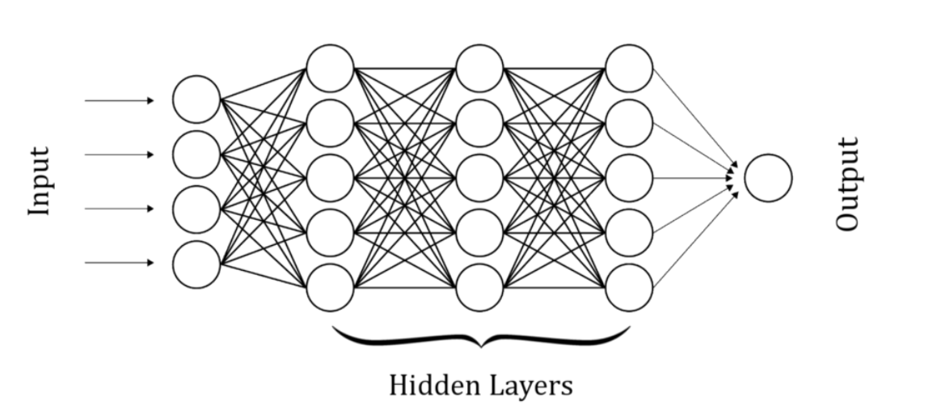
Neural Networks
Source :https://towardsdatascience.com/neural-networks-fundamentals-1b4c46e7dbfe

Slide 31
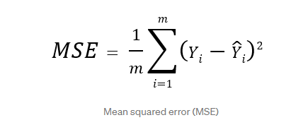
Neural Networks
Concepts
Cost Function :
This is required so that the model knows that it has made a mistake.
Identifies the gap between the desired output and output computed by model.
Objective is to minimize the cost function.
Weights are changed to minimize the cost function.
Example -> Mean Square Error.
Source :https://towardsdatascience.com/neural-networks-fundamentals-1b4c46e7dbfe

Slide 32
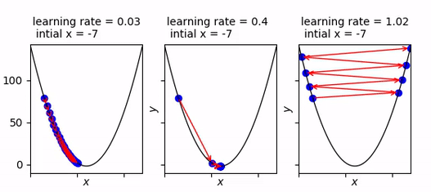
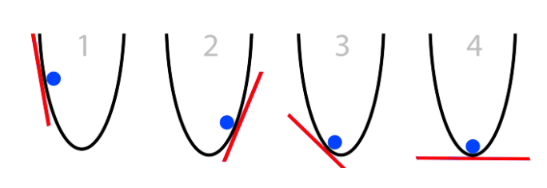
Neural Networks
Concepts
Gradient Descend:
This is a popular approach to the cost function optimization and training.
The learning rate determines the size of step towards the minimum.
Understand each weight’s contribution to the total error and then come towards values that minimize this error.
Source :https://towardsdatascience.com/neural-networks-fundamentals-1b4c46e7dbfe

Slide 33
Backpropagation

Slide 34
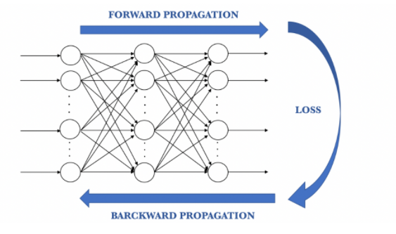
Backpropagation
Used for training networks
Backward pass
Update weights using gradual descent
Basically adjust the values of weights to minimize errors.
Source :https://www.kdnuggets.com/2019/10/introduction-artificial-neural-networks.html, https://hmkcode.com/ai/backpropagation-step-by-step/https://vinodsblog.com/2019/02/17/deep-learning-backpropagation-algorithm-basics/

Slide 35
Backpropagation
Backpropagation at work : https://hmkcode.com/netflow/
Source :https://www.kdnuggets.com/2019/10/introduction-artificial-neural-networks.html

Slide 36
Types of Neural Network

Slide 37
Neural Networks : Feed Forward Network
Also known as multi layered perceptron (MLP)
Source :https://www.analyticsvidhya.com/blog/2020/02/cnn-vs-rnn-vs-mlp-analyzing-3-types-of-neural-networks-in-deep-learning/

Slide 38
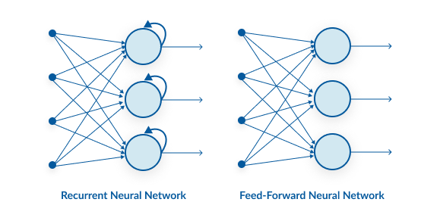
Neural Networks : Recurrent Neural Network
This network has a recurrent connection in the hidden layer.
Used for time series models
Good for inputs that come in sequences
Connection between previous and current state
Source :https://www.analyticsvidhya.com/blog/2020/02/cnn-vs-rnn-vs-mlp-analyzing-3-types-of-neural-networks-in-deep-learning/

Slide 39
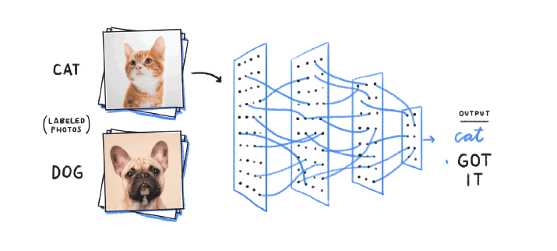
Neural Networks : Convolution Neural Networks
This is used for image processing
Gets spatial features (arrangement of pixels and relationships them in an image) from an image
Identify and locate objects and relationships between them in an image.
Source :https://www.analyticsvidhya.com/blog/2020/02/cnn-vs-rnn-vs-mlp-analyzing-3-types-of-neural-networks-in-deep-learning/

Slide 40
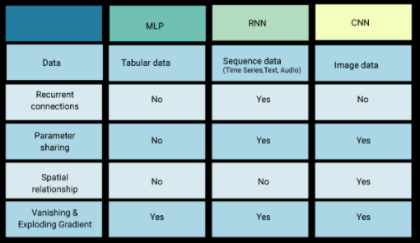
Neural Networks : Comparison
Source :https://www.analyticsvidhya.com/blog/2020/02/cnn-vs-rnn-vs-mlp-analyzing-3-types-of-neural-networks-in-deep-learning/

Slide 41
Session summary -------------------------------------------------------------
Supervised learning uses training datasets for models to predict outcomes
Unsupervised learning tries to find patterns and structures in the underlying data set.
Feed forward networks are essentially multilayered perceptron(s).
The activation function helps introduce non linearity in neural network models.
The backpropagation method helps in the adjustment of weights to minimize the error/cost function.
The learning rate gives the size of change during each ‘weight-adjustment’ step.

Slide 42
References ------------------------------------------------------------- https://www.expert.ai/products; DeepLearning.AI(thebatch@deeplearning.ai) https://machinelearningmastery.com https://datafloq.com https://deepai.org https://towardsdatascience.com https://medium.com/artificial-neural-networks https://highontechs.com/deep-learning/activation-functions-why-are-they-important/ https://hvidberrrg.github.io/deep_learning/activation_functions https://www.allaboutcircuits.com/technical-articles https://www.kdnuggets.com https://hmkcode.com https://vinodsblog.com/2019/02/17/deep-learning-backpropagation-algorithm-basics https://www.analyticsvidhya.com

Slide 43
Topics for next session
Neural Networks Continued

Slide 44
End of Session ------------------------------------------------------------------ Questions

